Slide 1

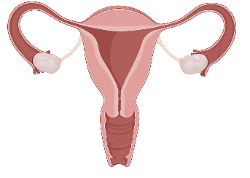
Cervical Cancer Screening
Pathophysiology
Screening
Management
Cases
Images created with BioRender.com

Slide 2
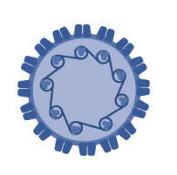

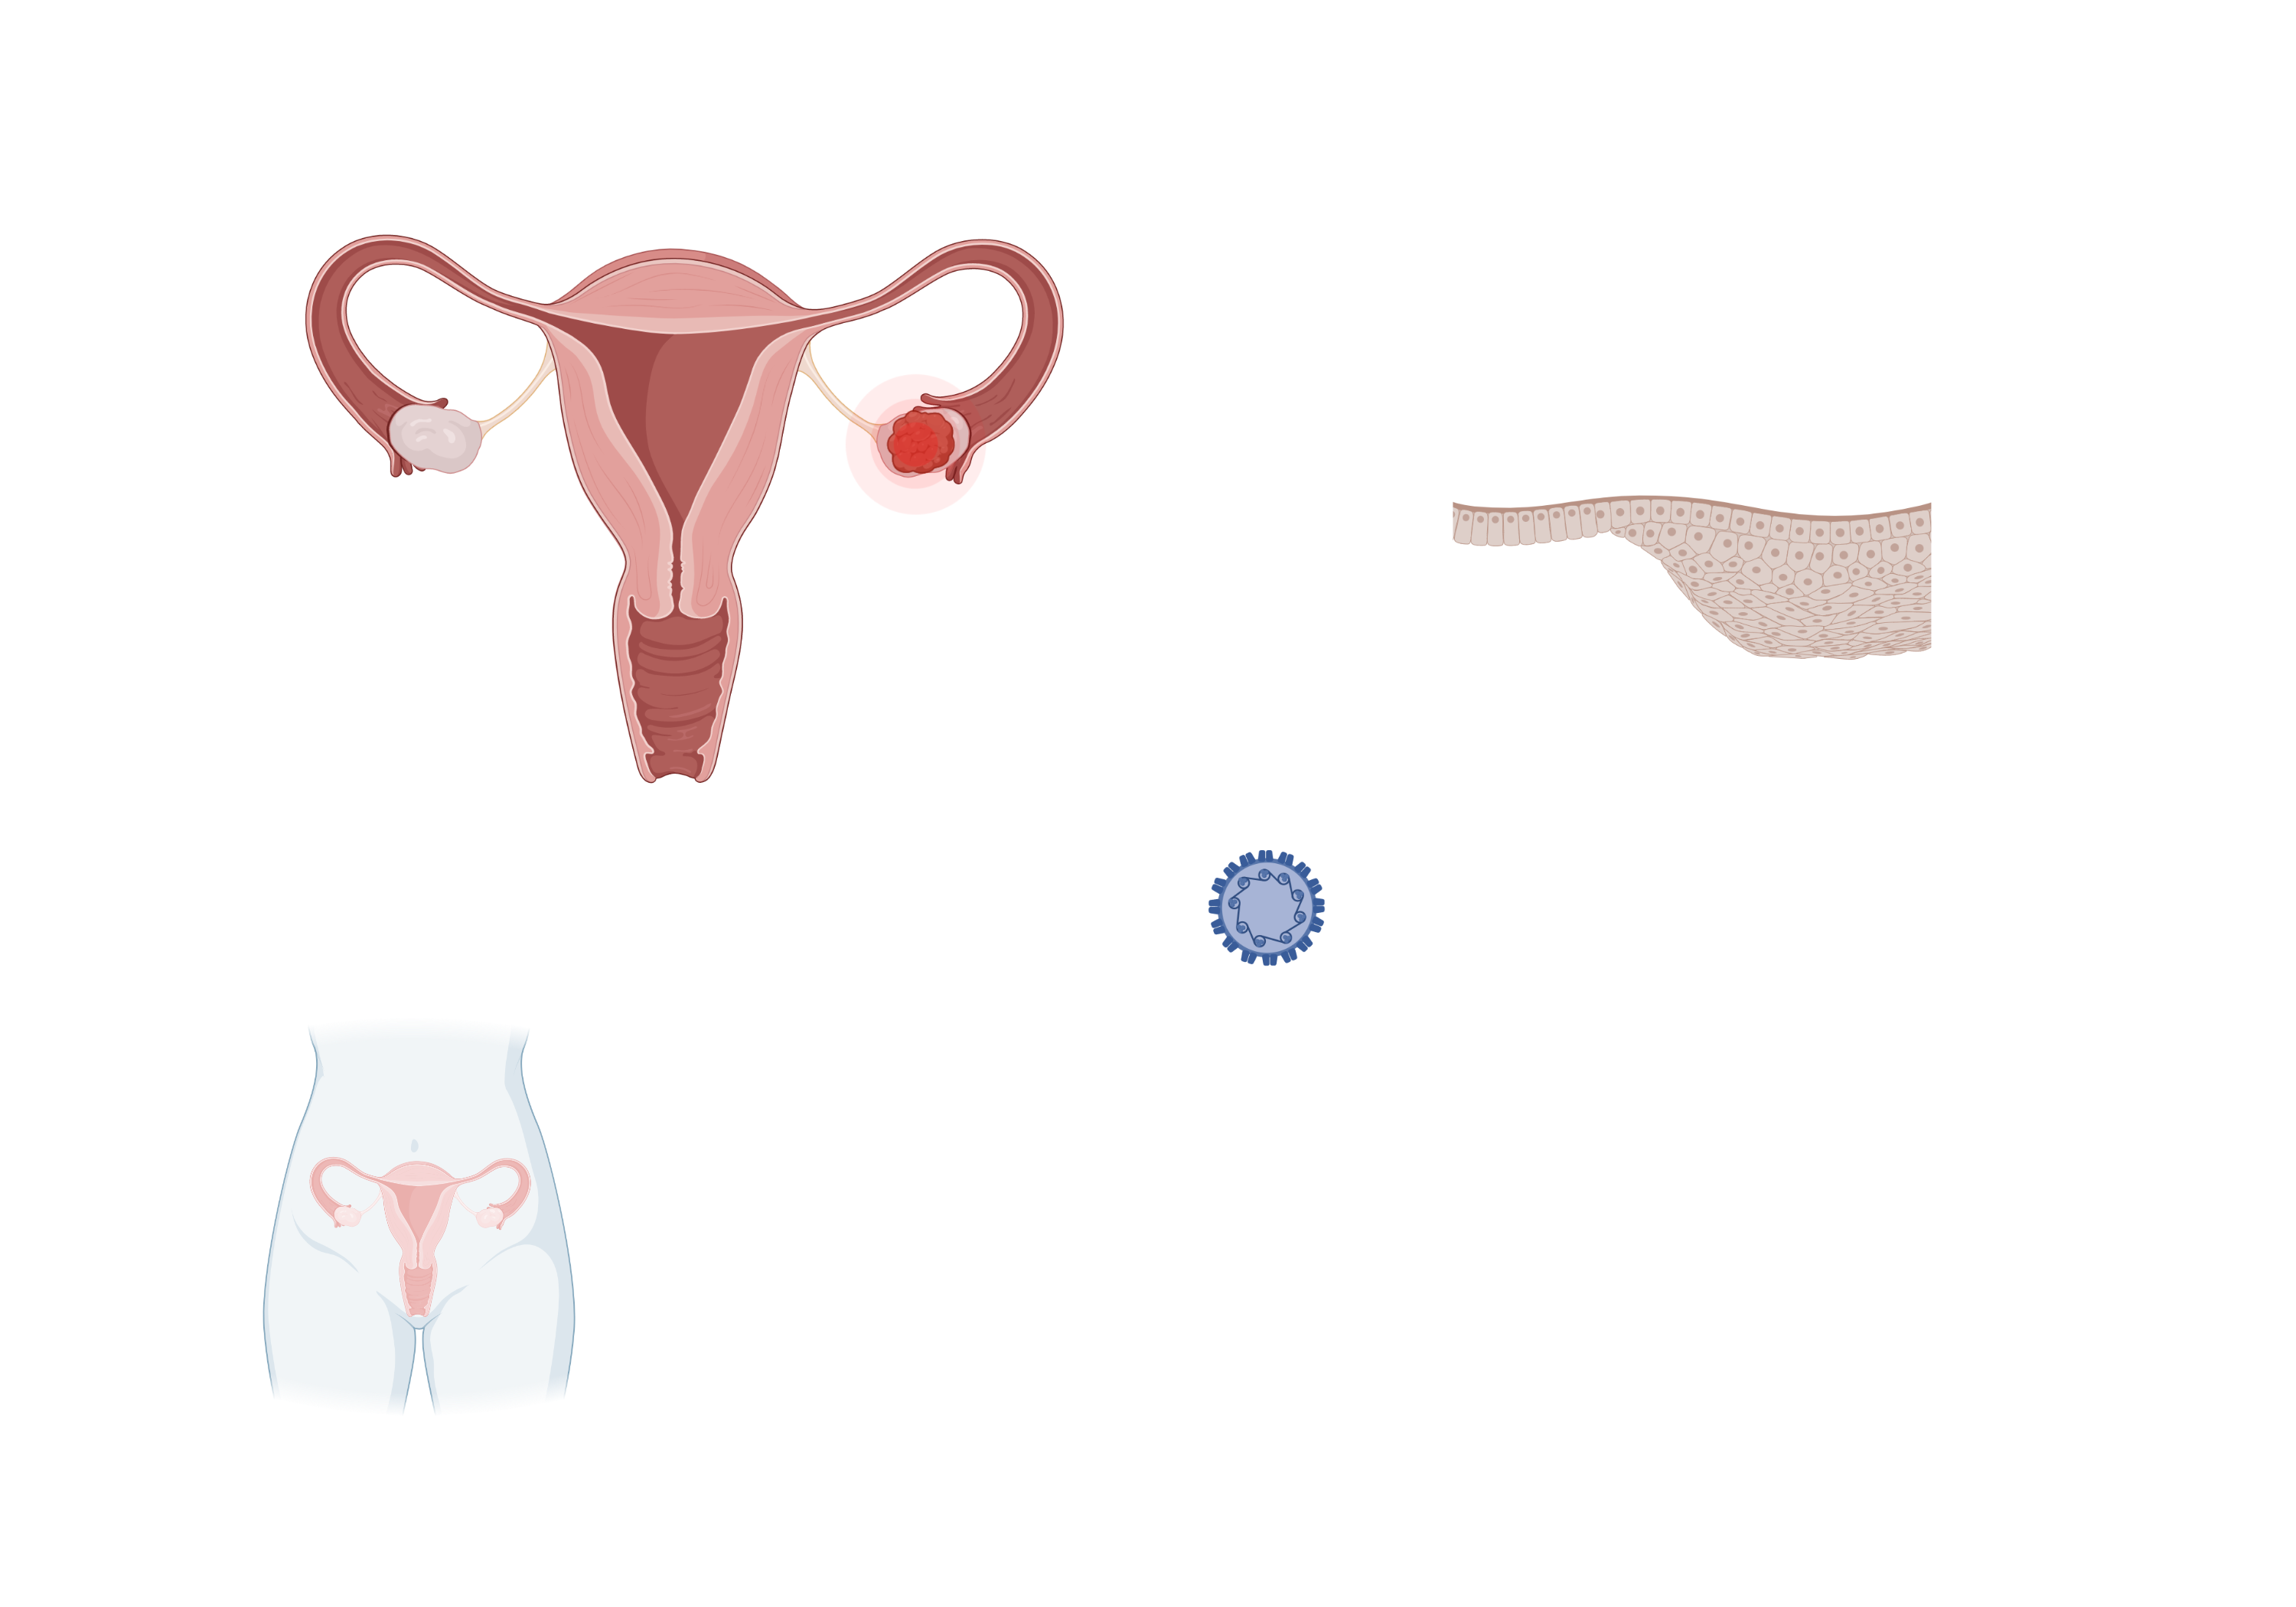
Pathophysiology
Pathophysiology
What causes cervical cancer?
What causes cervical cancer?
Risk factors for persistent HPV infection?
Risk factors for persistent HPV infection?
Cervical anatomy
Screening
Cervical anatomy
90% of cancers develop at the transformation zone
Management
High-risk subtypes (16 and 18)
Older age
Immunosuppression
Smoking
Infection with other STIs
cOCP use
Cases
HPV
(e.g., subtypes 16, 18)
Cervical cancer types
Cervical cancer types
Transformation zone
~10 y
Persistent HPV infection
Cervical cancer
10%
Transformation zone
Ectocervix
Endocervix
90%
Endocervix
(columnar)
Ectocervix
(squamous)
Spontaneous clearance (at 2 years)
SCC (75%)
Adenocarcinoma (25%)
Images created with BioRender.com

Slide 3
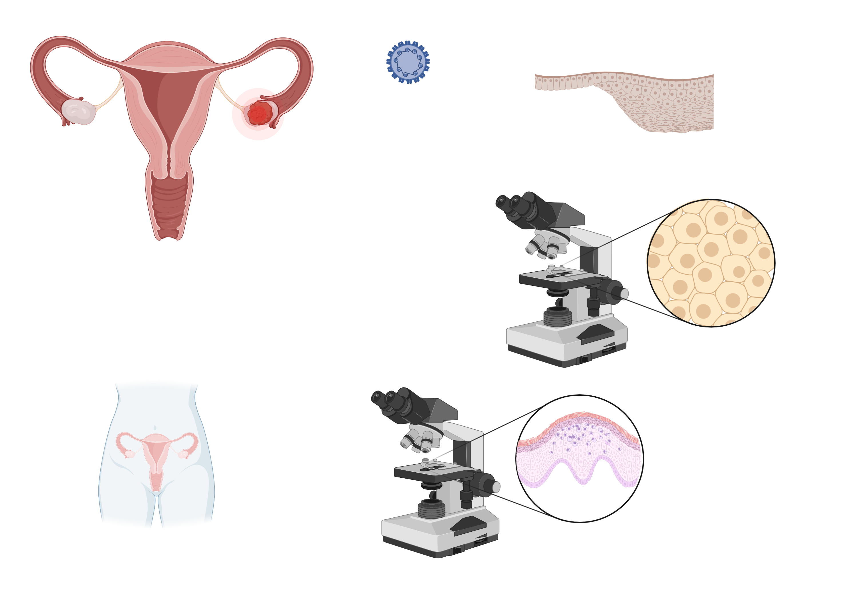
Pathophysiology
Screening
Detects treatable changes and precancers that are likely to progress to cancer
Screening
Persistent HPV infection
Cervical cancer
Atypia
Precancer
Average risk
High risk
Cytology
A Pap smear collects exfoliated cervical cells, which are examined for changes suggestive of acute HPV infection, precancer, or cancer
Cytology
Screening tests?
Screening tests?
Management
+/-
Cases
Primary HPV
Detects high risk types of HPV from a cervical sample
Primary HPV
Images created with BioRender.com
Notes:
Abbreviations:
CIN2+, cervical intraepithelial neoplasia (CIN) 2 or worse

Slide 4
Pathophysiology
Average Risk Patients
Patients without a history of immunocompromise or CIN2/CIN3
Screening
Average risk
USPSTF 2018
Cytology q3y
Cytology q3y | Co-test or primary HPV q5y
USPSTF 2018
High risk
Stop screening when:
No hx of CIN2+ for >25 y and adequate* prior screening x 10 y
When do we stop?
Age
20
30
40
50
60
70
Management
ACS 2020
ACS 2020
Primary HPV q5y > Co-test q5y | Cytology q3y
Cases
*2 neg HPV ± cytology (<5 y)
OR
3 neg cytology (<3 y)
Post-hysterectomy screening
What if they are post-hysterectomy?
Stop screening if total hysterectomy (cervix removed) for benign indications
AND
No history of CIN2+ within 25 y
Notes:
Abbreviations:
CIN2+, cervical intraepithelial neoplasia (CIN) 2 or worse

Slide 5
Pathophysiology
High-Risk Patients
High risk patients are those with immunocompromise or immunosuppression
Screening
HIV
Transplant (stem cell, solid organ)
SLE
IBD or RA on immunosuppression
Chronic steroid use
Average risk
High risk
Age
20
30
40
50
60
70
Management
Cytology q1y x 3 → q3y
Cytology q1y x 3 (if not previously done) → q3y
OR co-test q3y
Cases
Post-hysterectomy screening
What if they are post-hysterectomy?
Annual screening (cytology or co-test) if:
progressive HIV disease
viral suppression with ART cannot be achieved
Notes:
Abbreviations:
CIN2+, cervical intraepithelial neoplasia (CIN) 2 or worse

Slide 6
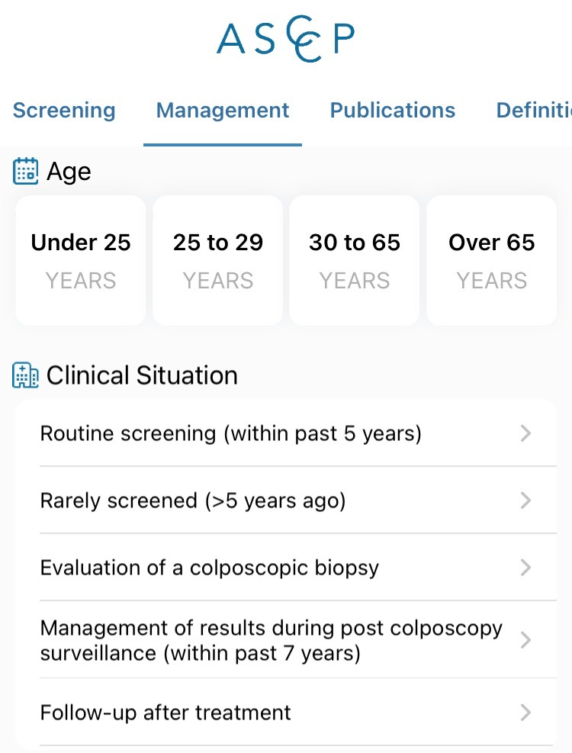
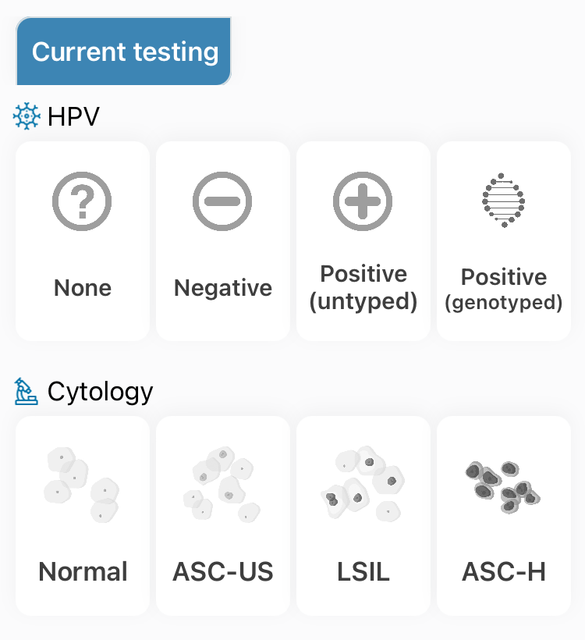
Pathophysiology
Management of Abnormal Results
High risk patient?
(immunosuppression, HIV, prior CIN2 or CIN3)
Follow screening and guidance for high-risk patients
Screening
High risk patient?
(immunosuppression, HIV, prior CIN2 or CIN3)
yes
Management
no
Surveillance
ASCCP Guidelines app
ASCCP Guidelines app
Further Tx
Immediate CIN3+ risk
High risk
<4%
>4%
Cases
Determine surveillance interval
Further management
Notes:
“All positive primary HPV screening tests, regardless of genotype, should have additional reflex triage testing performed from the same laboratory specimen"

Slide 7
Pathophysiology
Surveillance of Abnormal Results
High risk patient?
(immunosuppression, HIV, prior CIN2 or CIN3)
Follow screening and guidance for high-risk patients
Screening
yes
Management
no
Surveillance
ASCCP Guidelines app
Further Tx
Immediate CIN3+ risk
High risk
<4%
>4%
Cases
Determine surveillance interval
Further management
5-year CIN3+ risk
<0.15%
0.15-0.55%
>0.55%
Screen in 5 y
Screen in 3 y
Screen in 1 y
Notes:
“All positive primary HPV screening tests, regardless of genotype, should have additional reflex triage testing performed from the same laboratory specimen"

Slide 8
Pathophysiology
Management of Abnormal Results
High risk patient?
(immunosuppression, HIV, prior CIN2 or CIN3)
Follow screening and guidance for high-risk patients
Screening
yes
Management
no
Surveillance
ASCCP Guidelines app
Further Tx
Immediate CIN3+ risk
High risk
<4%
4-24%
25-59%
60-100%
Cases
Determine surveillance interval
Colposcopy
Colposcopy
or
Expedited treatment
Expedited treatment
(hysterectomy, ablation/excision)
Notes:
“All positive primary HPV screening tests, regardless of genotype, should have additional reflex triage testing performed from the same laboratory specimen"

Slide 9
Pathophysiology
Pap smear vs. Colposcopy
Pap smear
(cytology)
Prevalence of Abnormal Cells
Pap smear (cytology)
Screening
Cytologic findings
Management
Cytologic findings
Surveillance
NILM
ASC-US
LSIL | ASC-H | AGC
HSIL
Further Tx
Exfoliated cervical cells are examined for changes suggestive of acute HPV infection, precancer, or cancer
High risk
Colposcopy
(histology)
Cases
Colposcopy (histology)
Histologic LSIL
Histologic HSIL | AIS
Invasive cancer
No CIN
CIN1
CIN2
CIN3
Histologic findings
Histologic findings
Biopsied tissue architecture is assessed for vertical extension of abnormal cells
Images created with BioRender.com
Notes:
Abbreviations:
NILM, negative for intraepithelial lesion or malignancy
ASC-US, atypical squamous cells of undetermined significance
LSIL, low-grade intraepithelial lesion
ASC-H, atypical squamous cells, cannot rule out high-grade squamous intra-epithelial lesion
AGC, atypical glandular cells
HSIL, high-grade intraepithelial lesions
CIN, cervical intraepithelial neoplasia
AIS, adenocarcinoma in situ
Possible results:
NILM
ASC-US
LSIL
ASC-H
AGC
HSIL

Slide 10
Pathophysiology
Management – High Risk Patients
Immunosuppressed
History of CIN2 or CIN3
Screening
History of CIN2 or CIN3
HIV
Solid organ or stem cell transplant
SLE
IBD or RA on immunosuppression
Management
Surveillance
Surveillance
Total hysterectomy (no cervix)
Excision or ablation
Total hysterectomy (no cervix)
Excision or ablation
Management
Management
Further Tx
Colposcopy indicated for:
ASC-US and HPV +
LSIL | ASC-H | AGC or HSIL regardless of HPV status
High risk
Cases
HPV-based test at 6 months
3 consecutive annual negative HPV-based tests
q3yr HPV-based test for ≥25 years
Notes:
Abbreviations:
Heme, Hematopoietic
SLE, Systemic Lupus Erythematosus
IBD, Inflammatory Bowel Disease
RA, Rheumatoid Arthritis
SDM, shared-decision management

Slide 11
Pathophysiology
Case 1
40 year-old person with a cervix, HTN, depression presents for cervical cancer screening. Their co-test is negative and they have no prior history of abnormal pap smears.
Screening
Management
When should they be screened again?
…They undergo a colposcopy. Biopsy shows CIN2.
Because the patient had negative HPV-based testing, they should be re-screened in 5 years.
What if your next step in management or follow-up?
Cases
Go to app.asccp.org. Age: 30-65. Clinical situation: Evaluation of a colposcopic biopsy. Two options:
Treatment (excision > ablation) followed by HPV based testing at 6 months is recommended
For those concerned about impact of treatment on risk of adverse outcomes in future pregnancy, observation with colposcopy + HPV-based screening at 6 and 12 months is acceptable
1
…Five years later, they return to clinic for repeat screening. Primary HPV testing w/ reflex cytology shows HPV+ for a high risk strain other than 16 or 18, ASC-US.
2
What is your next step in management or follow-up?
Go to app.asccp.org. Age: 30-65. Clinical situation: Routine screening (within past 5 years). Enter current and prior screening results → HPV testing at 1 year is recommended.
How would you counsel your patient on the impact of a history of CIN2 on recommended screenings in the future?
…At 1 year follow-up, repeat testing still shows HPV+ other, ASC-US.
Short-term follow-up: depends on treatment choice.
Long term follow-up: they are considered high risk and will require screening at 3-year intervals for a minimum of 25 years (even if >65 years old)
What is your next step in management or follow-up?
Go to app.asccp.org. Colposcopy is recommended at this point.

Slide 12
Pathophysiology
Case 2
37 year-old person with a cervix, SLE on hydroxychloroquine presents for annual wellness exam. They report a normal pap smear 3 y ago but doesn't know if HPV was tested. They completed the HPV vaccine series.
Screening
Management
When and how should they be screened for cervical cancer?
When can they stop screening?
Cases
Given history of SLE on immunosuppression, continue screening every 3 years throughout the patient's lifetime (and not, as in the general population, end at 65 years of age), assuming patient is in reasonably good health.
Today. Screening can be done with cytology alone (Pap smear) or HPV co-test at least every 3 years given history of SLE.
1
…Pap smear returns with LSIL, HPV negative.
2
What is your next step in management?
Given their history of immunosuppression, colposcopy is indicated despite HPV status.

Slide 13
2025 Screening Update — risk-based framework unchanged
• USPSTF FINALIZED its cervical cancer screening update in 2025 (the deck cites the 2018 version). Average-risk ages 30–65: primary hrHPV every 5 years is now the PREFERRED strategy; cytology q3y remains an option.
• First-time endorsement of SELF-COLLECTED (patient-collected) hrHPV samples on an FDA-approved platform — non-inferior to clinician-collected (pooled CIN2+ Sn ~0.86, Sp ~0.81); expands access for patients who decline a speculum exam.
• Ages 21–29: cytology alone every 3 years (unchanged). The American Cancer Society (2025) recommends starting at age 25 with primary hrHPV and also endorses self-collection.
• Unchanged: HPV as the cause; ASCCP 2019 risk-based ("equal management for equal risk," 4% immediate-CIN3+ threshold, app.asccp.org) for abnormal results; distinct protocols for HIV/immunosuppressed; stop at 65 if adequate prior screening and no CIN2+ within 25 y.
– Sources: USPSTF Cervical Cancer Screening, final 2025 (Grade A); ACS 2025 guideline update (CA Cancer J Clin); ASCCP Self-Collection Practice Advisory, Oct 2025. Confirm your lab/platform offers an FDA-approved self-collection assay before adopting.

Slide 14
Take-Home Points
• Persistent infection with oncogenic HPV subtypes (chiefly 16 & 18) causes nearly all cervical cancer; >90% arises at the transformation zone, so sampling it is essential.
• Average-risk screening: cytology alone q3y (21–65), or HPV-based testing (primary hrHPV or co-test) q5y (30–65). USPSTF 2025 + ACS prefer primary hrHPV and now endorse self-collection. Stop at 65 with adequate prior screening and no CIN2+ within 25 y.
• Manage abnormal results by the ASCCP 2019 risk-based app: immediate CIN3+ risk <4% → surveillance interval (1/3/5 y by 5-year risk); 4–24% → colposcopy; 25–59% → colposcopy or expedited treatment; ≥60% → expedited treatment.
• Immunocompromised/immunosuppressed patients (HIV, transplant, SLE, IBD/RA on immunosuppression) are higher-risk: start at diagnosis, screen more often (cytology or co-test, not primary HPV in HIV), continue for life, and have a lower threshold for colposcopy.
• History of CIN2+ requires long-term surveillance: HPV-based testing q3y for ≥25 years, even beyond age 65.

Slide 15
Attribution & Changelog
• Original: "Cervical Cancer Screening," TeachIM.org, published Dec 2022 — Rebecca S. Gold MD, Heather Wainstein MD, Meagan Williams MD; Section Ed. Adelaide McClintock MD; Exec. Ed. Yilin Zhang MD.
– https://teachim.org/teaching_material/cervical-cancer-screening/ — CC BY-NC 4.0 (attribution required, non-commercial). Optimized June 2026. Deck: Cervical-cancer-1.23.pptx (page embed URL).
• Correction to this copy (all click-to-reveal animations & BioRender graphics preserved):
– Slide 10: high-risk colposcopy criteria "LSIL | ASC-H | AGS" → "AGC" (atypical glandular cells; deck slide 9 uses AGC correctly).
• Appended: this changelog + 2025 Screening Update + Take-Home slides. No original content removed; 12 original slides → 15.
• Companion copied & linked (reviewed, unchanged): cervical-cancer-screening_1.23.pdf (printable teaching guide / learner handout). Package: HTML, OnePager PDF, Anki TSV.
• Educational use only — not medical advice; clinician-review before teaching.

